Slide 1



Consumption Analysis
Last data refresh:
6/3/2021 6:17:57 AM UTC
Downloaded at:
6/3/2021 6:34:25 AM UTC

Slide 2
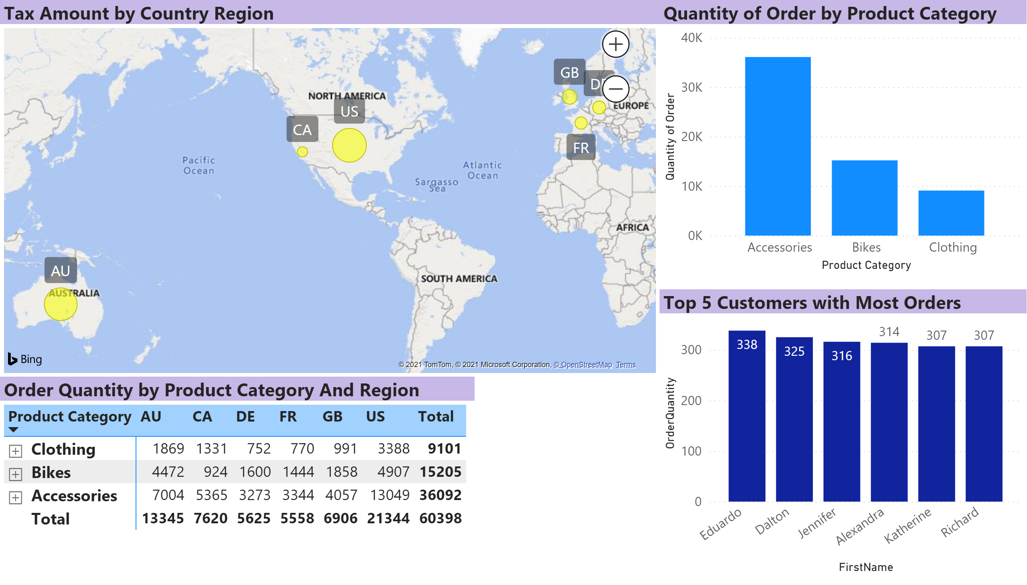
Page 1
Notes:
Tax Amount by Country Region
No alt text provided.
Order Quantity by Product Category And Region
No alt text provided.
Quantity of Order by Product Category
No alt text provided.
Top 5 Customers with Most Orders
No alt text provided.

